Slide 1
Tuning Oracle Database Performance via AWR and code changes - a case study

Slide 2
Introduction
In this presentation, I will give all of you an example of Oracle DB performance tuning.
By applying code changes as well as DBA skills, a Oracle database based web system got huge performance gain.
10 times more concurrent users
And
100+ times reduction of page response time!

Slide 3
Background
1. University course option choice online – ‘black Friday’ event
2. 3,000+ students hit system simultaneously.
3. Framework:
mod_PLSQL forward web request from Apache to Oracle DB.
4. System symptom:
Web page response time – extremely high ( hours )
CPU usage – low (around 25%)
Concurrent session – high (up to 2,800)
I/O request – high ( up to 500 per second)

Slide 4
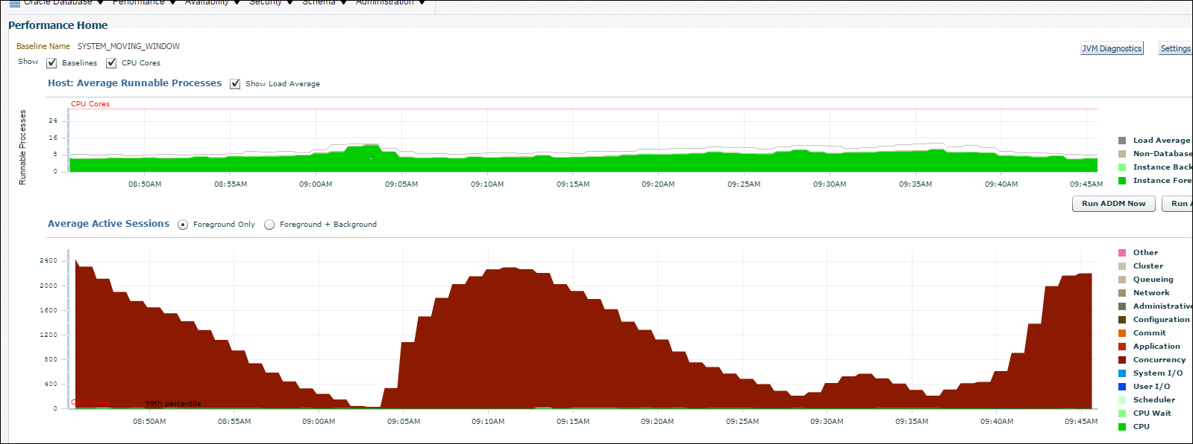

Slide 5
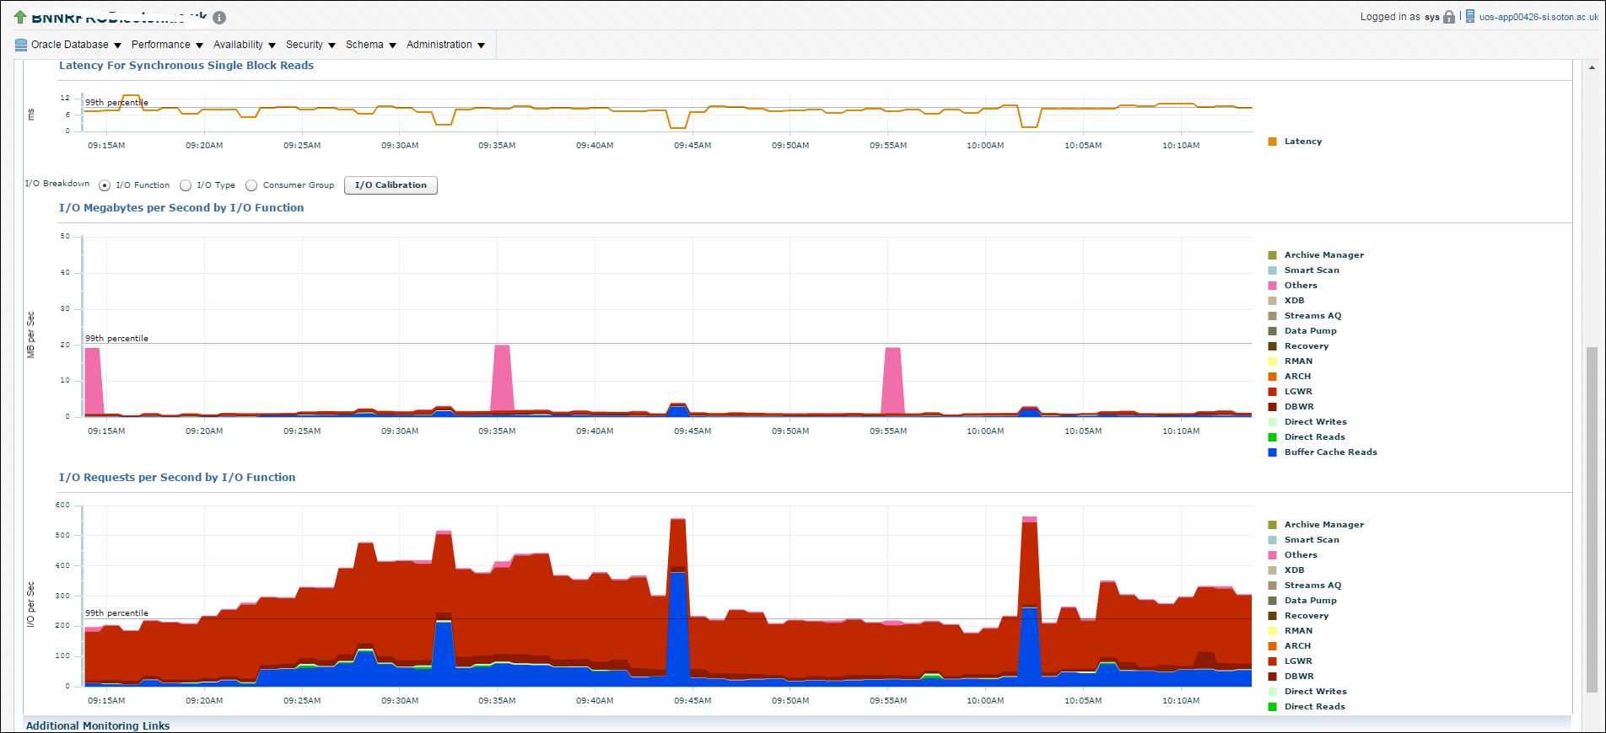

Slide 6
Performance diagnose & tuning methodology
1. AWR report
Top 10 Foreground Events by Total Wait Time
==> Wait Event Histogram
==> Segment Statistics
==> SQL ordered by Elapsed Time
SQL ordered by CPU Time
SQL ordered by User I/O Wait Time
SQL ordered by Gets
SQL ordered by Reads

Slide 7
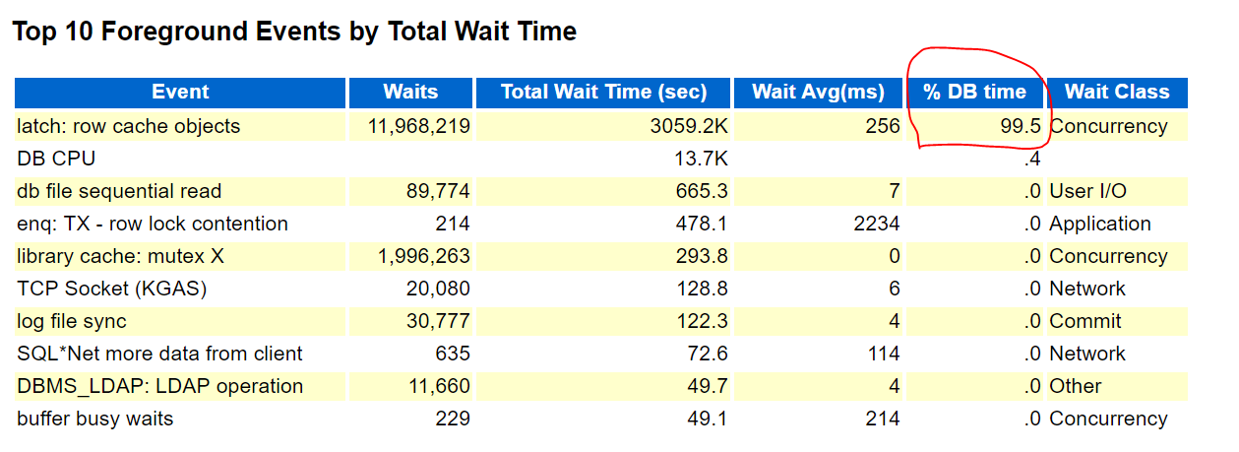
AWR report

Slide 8
SQL ordered by Elapsed Time
Elapsed Time (s) | Executions | Elapsed Time per Exec (s) | %Total | %CPU | %IO | SQL Id | SQL Module
2,472,551.14 | 4,648 | 531.96 | 80.45 | 0.26 | 0.00 | cgja42az8smg5 | httpd.worker@uos-app00446-vs (TNS V1-V3)
gja42az8smg5 | declare rc__ number; simple_list__ owa_util.vc_arr; complex_list__ owa_util.vc_arr; begin owa.init_cgi_env(:n__, :nm__, :v__); htp.HTBUF_LEN := 63; null; null; simple_list__(1) := 'sys.%'; simple_list__(2) := 'dbms\_%'; simple_list__(3) := 'utl\_%'; simple_list__(4) := 'owa\_%'; simple_list__(5) := 'owa.%'; simple_list__(6) := 'htp.%'; simple_list__(7) := 'htf.%'; simple_list__(8) := 'wpg_docload.%'; simple_list__(9) := 'ctxsys.%'; simple_list__(10) := 'mdsys.%'; if ((owa_match.match_pattern(p_string => 'bwkkspgr.showpage' /* */, p_simple_pattern => simple_list__ , p_complex_pattern => complex_list__ , p_use_special_chars => false))) then rc__ := 2; else twbklist.p_main; null; bwkkspgr.showpage(page=>:page); if (wpg_docload.is_file_download) then rc__ := 1; wpg_docload.get_download_file(:doc_info); null; null; null; commit; else rc__ := 0; null; null; null; commit; owa.get_page(:data__, :ndata__); end if; end if; :rc__ := rc__; end;

Slide 9
1st issue – waits: cache: row cache objects
1. Find suspicious procedure:
bwkkspgr.showpage ,
Average execution time: 531.96 seconds
%Total Elapsed Time : 80.45%
2. Locate problematic code:
Function INSTR & SUBSTR with CLOB variable LV_PAGEDEF executed 3000+ times for one page rending process!
99% of showpage execution time spend in this loop
CAN’T find document on this issue, just guess ,tested and proved

Slide 10
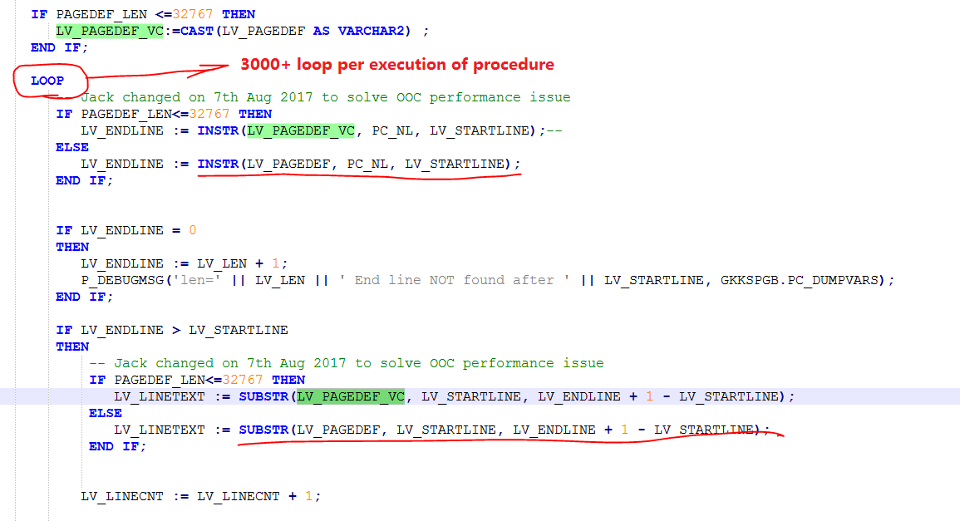
3. Solution – replace CLOB with varchar when size is below 32,767
LV_PAGEDEF CLOB;
LV_PAGEDEF_VC VARCHAR2(32767); --Added to solve performance issue

Slide 11
3. Result – 99.99% row cache objects wait event gone
1) Elapsed time for cgja42az8smg5 changed from 531.96 to 0.95 seconds
2) Improvement ratio: 55 , 900 % !!!
3) Latch: row cache objects waits: changed from 12M to 285 !!!

Slide 12
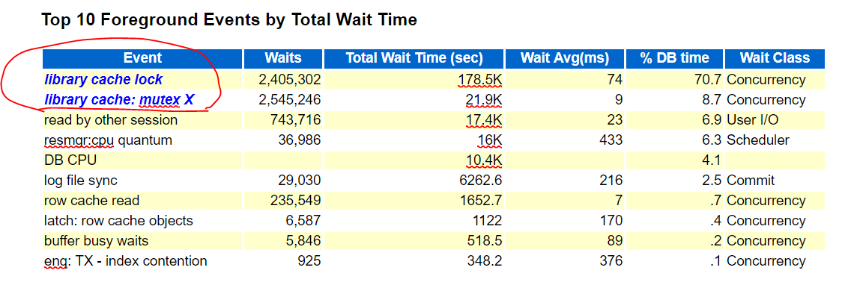
2nd issue – Waits: library cache
1. AWR report – from load test
No PL/SQL coding issue found.

Slide 13
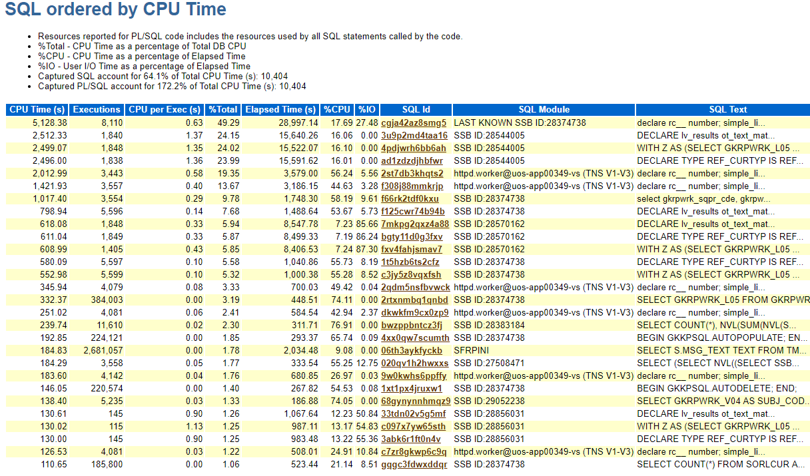

Slide 14
2. DB looks good, then how about Apache side?
Error messages found in Apache mod_plsql logging files
……
<1729057634 ms>StrArrPosBind pos 23 Charset Id : 46
<1729184884 ms>Execute: ORA-06550: line 35, column 3:
PLS-00306: wrong number or types of arguments in call to 'SHOWPAGE'
ORA-06550: line 35, column 3:
PL/SQL: Statement ignored
<1729184884 ms>(wppr.c,638) Execute:declare
……
Execution time: 184884-57634=127.250 s
-- 127 seconds execution time spend per call with PLS-00306 thrown at 1729057634

Slide 15
3. Error
1) MOD_PLSQL overhead issue:
……This works for most cases but fails if there is an attempt to pass a single value for an array parameter or pass multiple values for a scalar. In such cases, the first attempt to execute the PL/SQL procedure fails. mod_plsql issues a Describe call ……
2) If you define an array type parameter for procedure, but only send one value to it, Oracle mod_plsql will trigger
3) What Oracle don’t say is ‘ this procedure will spend 127 seconds for just one call’

Slide 16
4. Dirty hard-coding can improve performance – a lot !!!
Poor hard-coding for one page UOS_PMDM_OOC_5 only, save 127s per call
SUBTYPE ST_TEXT IS VARCHAR2(4000);
PROCEDURE SHOWPAGE3(
PAGE VARCHAR2
,PFROMPAGE VARCHAR2
,PSUBMIT VARCHAR2
,PFORM VARCHAR2
,PQRYCHKSUM VARCHAR2
,PDATAITEMS T_QNAMES
,C01 ST_TEXT
,C02 ST_TEXT
,C03 ST_TEXT
)
Beautiful coding with extremely poor performance
TYPE T_VARCHARS IS TABLE OF ST_TEXT
INDEX BY BINARY_INTEGER;
PROCEDURE SHOWPAGE(
PAGE VARCHAR2
……
,C01 T_VARCHARS
,C02 T_VARCHARS
……
,C38 T_VARCHARS
,C39 T_VARCHARS
,C40 T_VARCHARS
,ml_text_id T_VARCHARS
,ml_text T_VARCHARS
)

Slide 17
3rd issue: High water mark – DBA time
1. Classical dilemma – read or write ?
A big table GKRPWRK heavily used in procedure for temporarily store web page parameter for each call
– insert/update/select simultaneously for the same table!!
2 million historical records , for each event, 300,000 rows will be generated.
2. First reaction – remove historical records, then query & update, insert . However, I got below high watermark issue:

Slide 18
Event | Waits | Total Wait Time (sec) | Wait Avg(ms) | % DB time | Wait Class
enq: HW - contention | 1,637 | 8012.9 | 4895 | 55.7 | Configuration
latch: cache buffers chains | 4,304 | 2773.5 | 644 | 19.3 | Concurrency
resmgr:cpu quantum | 7,990 | 2323.1 | 291 | 16.2 | Scheduler
DB CPU |  | 567 |  | 3.9
buffer busy waits | 6,119 | 384.3 | 63 | 2.7 | Concurrency
log file sync | 350 | 307.9 | 880 | 2.1 | Commit
latch: In memory undo latch | 160 | 304.4 | 1903 | 2.1 | Concurrency
library cache: mutex X | 449 | 26.3 | 59 | .2 | Concurrency
latch free | 111 | 17.7 | 160 | .1 | Other
direct path sync | 61 | 11 | 180 | .1 | User I/O

Slide 19
3. Solution:
Change freelist for LOB segment - Rebuilding LOB freepools (Doc ID 365156.1)
Move table GKRPWRK to an independent table space TA, change ASM to manually managed table space set freelist to 96 (maximum allowed value).
Pro: high watermark wait gone and performance great
Cons: Table space will not shrink when data removed……
==> Create 2nd ASM table space for table GKRPWRK, move it to ASM table space after black Friday event end ( next weekend).

Slide 20
Final Result
1. Before tuning
Page response time (all 5 pages): hours (from numerous students’ complain)
Concurrent users in queue: 20-40
CPU usage: 25%
2. After tuning
Page response time (each page): 1 -2 seconds (Google Analytics)
Concurrent users in queue: 200
CPU usage: below 10%

